Slide 1
Understanding the most common restaurants in Toronto
Problem
Understanding which neighborhoods have which restaurants as the most common
Dataset :
Wikipedia
Geospacial Data
FourSquare

Slide 2
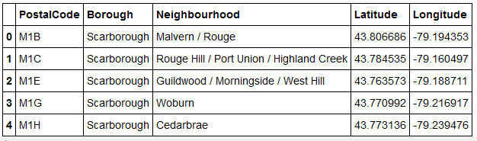
Final Extraction of Neighborhood and Geo Location Data

Slide 3
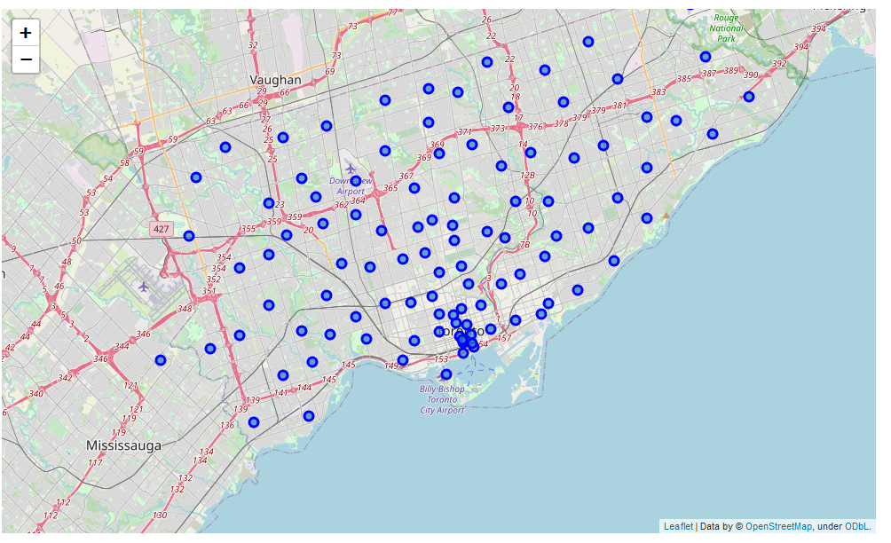
Representing the Locations through Maps

Slide 4
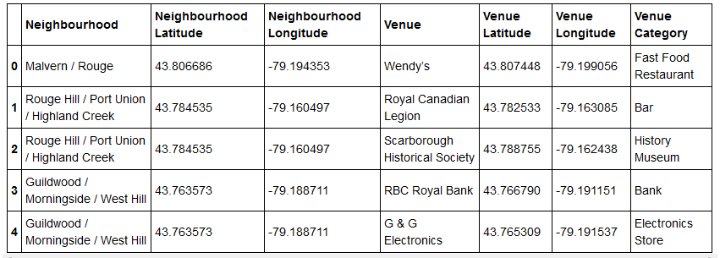
Extracting Nearby venues from Four Square

Slide 5
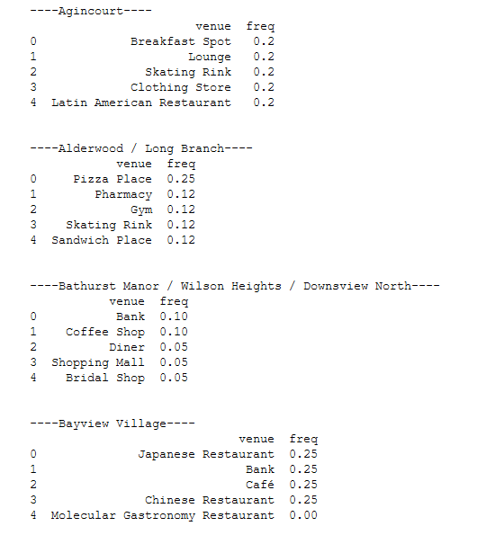
Breaking down the frequency of each venue

Slide 6
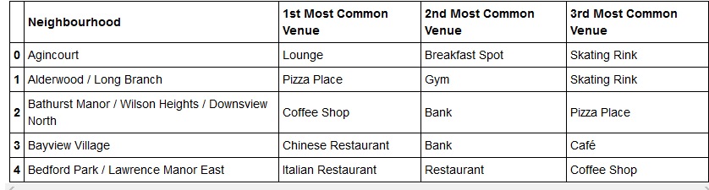
Understanding each common Venue

Slide 7
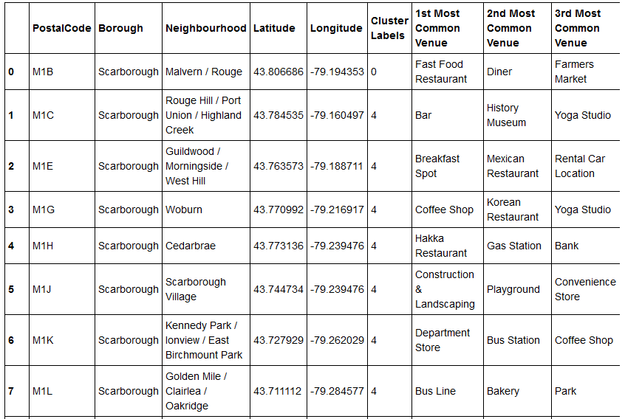
Breaking Down Venues into Clusters

Slide 8
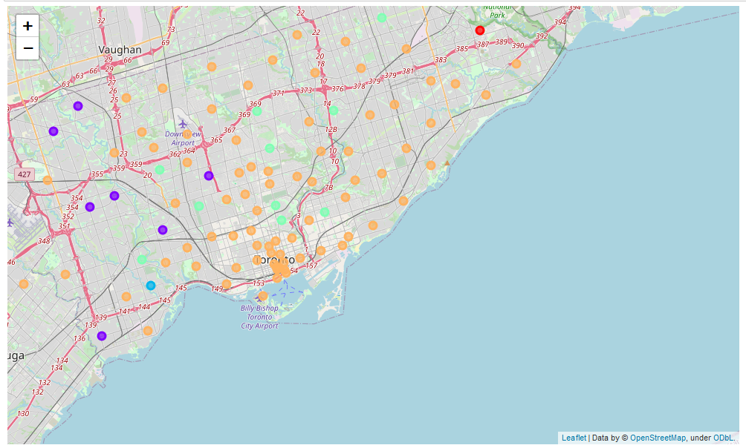
Representing the various clusters through maps

